Slide 1
Translation: from research to innovaton

Slide 2
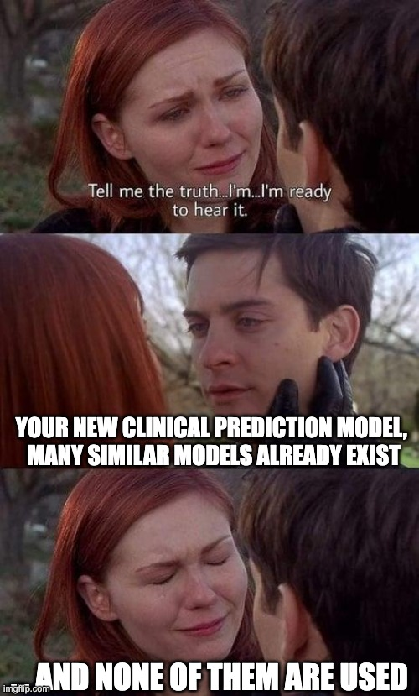
The truth about prediction models
https://twitter.com/MaartenvSmeden/status/1459889566656217092

Slide 4
The tower of achievement
Study of effects
System deployment
System
development
Model formulation
Friedman CP, J Am Med Informatics Assoc. 1995;2:65-67.

Slide 5
The tower of achievement
Study of effects
System deployment
System
development
Model formulation
Friedman CP, J Am Med Informatics Assoc. 1995;2:65-67.

Slide 6
The tower of achievement
Study of effects
System deployment
System
development
Model formulation
Friedman CP, J Am Med Informatics Assoc. 1995;2:65-67.

Slide 7
The tower of achievement
Study of effects
System deployment
System
development
Model formulation
Friedman CP, J Am Med Informatics Assoc. 1995;2:65-67.

Slide 8
The tower of achievement
Study of effects
System deployment
System
development
Model formulation
Friedman CP, J Am Med Informatics Assoc. 1995;2:65-67.

Slide 9
CDSS based on prediction model
Study of effects
System deployment
System
development
Model formulation
Friedman CP, J Am Med Informatics Assoc. 1995;2:65-67.

Slide 10
CDSS based on prediction model
Study of effects
System deployment
System
development
Model formulation
Derive a clinical prediction model from data (using statistical modelling or machine learning)
Friedman CP, J Am Med Informatics Assoc. 1995;2:65-67.

Slide 11
CDSS based on prediction model
Study of effects
System deployment
Create software that embeds the model and can be used for decision support in clinical practice
System
development
Model formulation
Derive a clinical prediction model from data (using statistical modelling or machine learning)
Friedman CP, J Am Med Informatics Assoc. 1995;2:65-67.

Slide 12
CDSS based on prediction model
Study of effects
Make the software available to healthcare professionals and give them instructions on how to use it
System deployment
Create software that embeds the model and can be used for decision support in clinical practice
System
development
Model formulation
Derive a clinical prediction model from data (using statistical modelling or machine learning)
Friedman CP, J Am Med Informatics Assoc. 1995;2:65-67.

Slide 13
CDSS based on prediction model
Study of effects
Evaluate whether clinical decisions are affected by the system
Make the software available to healthcare professionals and give them instructions on how to use it
System deployment
Create software that embeds the model and can be used for decision support in clinical practice
System
development
Model formulation
Derive a clinical prediction model from data (using statistical modelling or machine learning)
Friedman CP, J Am Med Informatics Assoc. 1995;2:65-67.

Slide 14
How many systems make it to the top?
Study of effects
?
System deployment
23 models currently recommended by NICE guidelines¹
System
development
?
Hundreds of clinical prediction models published in the literature each year (232 for Covid19 alone)
Model formulation
¹ Tsvetanova A et al. J Clin Epidemiol. 2021 Sep 11;140:149-158.

Slide 15
Discussion: Why do so few systems make it to the top?
Study of effects
?
System deployment
23 models currently recommended by NICE guidelines¹
System
development
?
Hundreds of clinical prediction models published in the literature each year (232 for Covid19 alone)
Model formulation
¹ Tsvetanova A et al. J Clin Epidemiol. 2021 Sep 11;140:149-158.

Slide 16
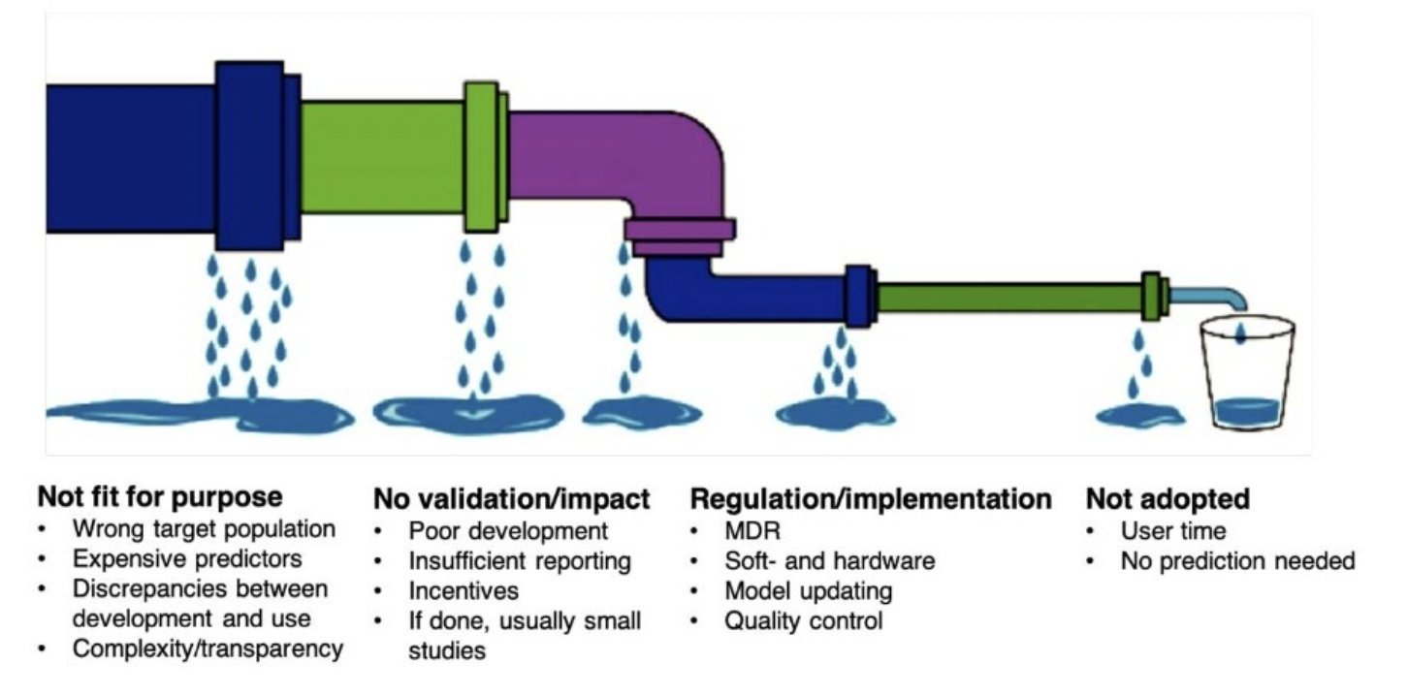
The leaky translational pipeline for prediction models
https://twitter.com/MaartenvSmeden/status/1459890265578217472

Slide 17
Impact of prediction models
By impact of a prediction model we mean the changes that deployment of the model in clinical practice has had on clinical decision making and, ultimately, patient outcomes.
Many prognostic models have been validated for predictive accuracy in external datasets.
But remarkably few models have been evaluated for impact in clinical practice – there is a huge "evidence gap".
In the cases where it did happen, the results were not always positive.

Slide 18
Example: Preventing emergency hospital admissions with PRISM
Prism is a web based predictive risk tool that stratifies people into four levels based on their individual risk of an emergency admission to hospital in the following 12 months.
Risk group 1: 80% of the practice population with the lowest scores
Risk group 2: the 15% with the next high scores
Risk group 3: the 4.5% with the next high scores
Risk group 4: the 0·5% at highest risk of emergency hospital admission
The Prism tool was developed and validated using 300,000 (10% of the Welsh population) anonymised GP and hospital records from which 37 variables with the highest predictive power were selected.

Slide 19
Example: Preventing emergency hospital admissions with PRISM
Validation of PRISM (n=51,600): c=0.749.
The model generally under-predicted risk at higher risk levels and over-predicted risk at the lowest risk level.
Introduction of the PRISM model into primary care resulted in more emergency hospital admissions and use of other NHS services without evidence of benefits to patients or the NHS.
Snooks H, et al. BMJ Qual Saf 2019;28:697–705.

Slide 20
Summary: Translation
The translation of new systems/technologies to clinical practice is a complex process involving various steps
Many clinical prediction models are published each year, but few are being used in clinical practice
Even fewer models have been tested for the impact that they had on clinical decision making
And when that happened, the results were not always positive

Slide 21
Discussion
Several models that had reasonable (or even good) predictive performance in validation sets, failed to improve health outcomes in clinical studies.
What could be the explanation for this?

Slide 22
What we have discussed in this lecture
Clinical prediction models
Clinical decision support
Translation: from research to clinical practice

Slide 23
Some recent papers from our group
Tsvetanova A, Sperrin M, Peek N, et al. Missing data was handled inconsistently in UK prediction models: a review of methods used. J Clin Epidemiol. 2021 Sep;140:149-58.
Lin L, Sperrin M, Jenkins DA, et al. A scoping review of causal methods enabling predictions under hypothetical interventions. Diagn Progn Res. 2021 Feb;5(1):3.
Jenkins DA, Martin GP, Sperrin M, et al. Continual updating and monitoring of clinical prediction models: time for dynamic prediction systems? Diagn Progn Res. 2021 Jan;5(1):1.
Sisk R, Lin L, Sperrin M, et al. Informative presence and observation in routine health data: A review of methodology for clinical risk prediction. J Am Med Inform Assoc. 2021;28(1):155-66.
Sperrin M, Martin GP, Sisk R, et al. Missing data should be handled differently for prediction than for description or causal explanation. J Clin Epidemiol. 2020 Sep;125:183-7.
Bull LM, Lunt M, Martin GP, et al. Harnessing repeated measurements of predictor variables for clinical risk prediction: a review of existing methods. Diagn Progn Res. 2020 Jul;4:9.
Sperrin M, Jenkins D, Martin GP, et al. Explicit causal reasoning is needed to prevent prognostic models being victims of their own success. J Am Med Inform Assoc. 2019 Dec;26(12):1675-6.
Sperrin M, Martin GP, Pate A, et al. Using marginal structural models to adjust for treatment drop-in when developing clinical prediction models. Stat Med. 2018 Dec;37(28):4142-54.

Slide 24



Thank you
Niels Peek
Centre for Health Informatics
The University of Manchester, UK
niels.peek@manchester.ac.uk
@NielsPeek

